Slide 1
Digital Portfolio
STUDENT NAME:VISHNU PRAKASH S
REGISTER NO AND NMID:2428B0364
DEPARTMENT:B.SC COMPUTER SCIENCE WITH DATA ANALYTICS
COLLEGE:KPR COLLAGE OF ARTS SCIENCE AND RESEARCH
UNIVERSITY:BHARATHIYAR UNIVERSITY

Slide 2
PROJECT TITLE
Workshops, Certifications, Training, Attendance

Slide 3


AGENDA
Problem Statement
Project Overview
End Users
Tools and Technologies
Portfolio design and Layout
Features and Functionality
Results and Screenshots
Conclusion
Github Link
3/21/2024 Annual Review

Slide 4

PROBLEM STATEMENT
Students lack a structured platform to present their skills, projects, and achievements.
Traditional resumes do not highlight practical exposure, certifications, or workshops.
Recruiters face challenges in evaluating technical expertise and learning outcomes.
A digital portfolio system is needed to present a professional profile.

Slide 5

PROJECT OVERVIEW
The project is about creating a Digital Portfolio Platform for students.
Showcases academic details, projects, certifications, and workshops in a structured manner.
Enhances career opportunities by making profiles more transparent and professional.
Provides an easy way to update and present achievements online.

Slide 6

WHO ARE THE END USERS?
Students – Showcase their learning, projects, and certifications.
Recruiters/Companies – Evaluate students beyond resumes.
Educational Institutions – Monitor student participation and growth.
Peers & Mentors – Collaborate, inspire, and provide feedback.

Slide 7

TOOLS AND TECHNIQUES
Frontend: HTML, CSS, JavaScript, Bootstrap/React.
Backend: Node.js / Python Flask / Django.
Database: MySQL / MongoDB.
Design Tools: Canva, Figma.
Version Control: GitHub.
Hosting: GitHub Pages / Netlify / Vercel.

Slide 8
devices.
POTFOLIO DESIGN AND LAYOUT
Homepage: Photo, introduction, contact details.
About Section: Education, skills, career objectives.
Projects Section: With descriptions, screenshots, and GitHub links.
Certifications & Workshops: Highlighting technical expertise.
Training & Attendance: Proof of active participation.
Responsive Layout: Accessible across
8

Slide 9
FEATURES AND FUNCTIONALITY
Easy profile customization and updates.
Organized sections for education, projects, and certifications.
Integration of GitHub links for live projects.
Downloadable resume option.
Contact and social media integration.
Mobile-friendly, responsive design.

Slide 10
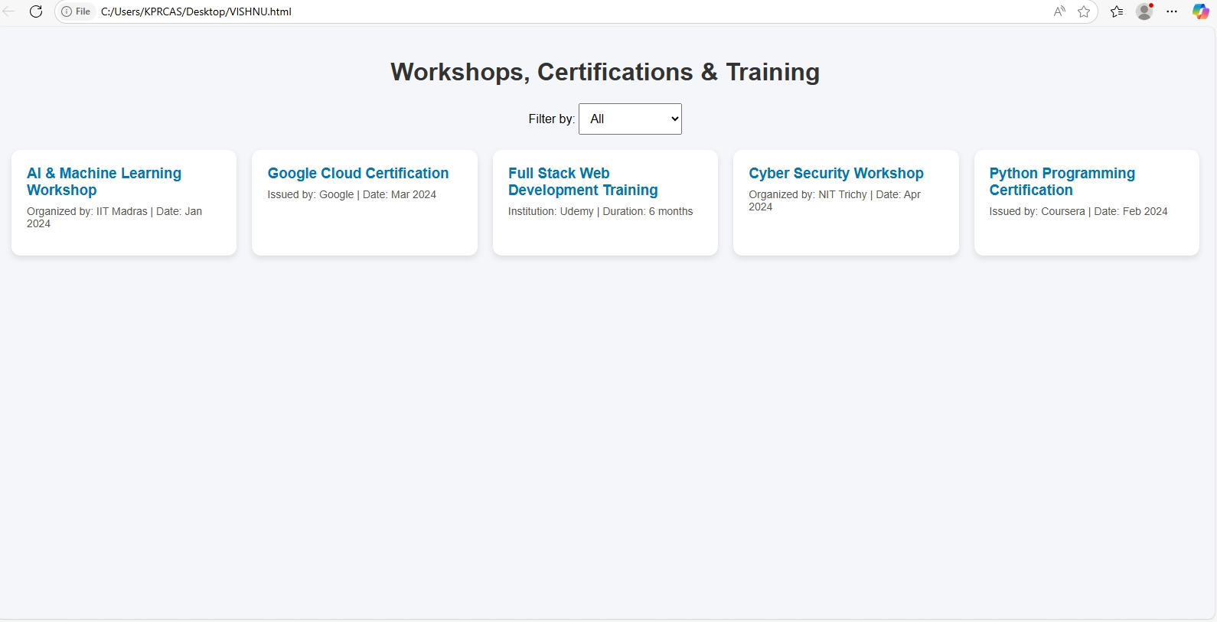

RESULTS AND SCREENSHOTS
Successfully developed a professional portfolio with structured sections.
Screenshots include:
  Homepage with profile introduction.
  Project showcase with GitHub links.
  Certifications and workshops displayed neatly.
  Attendance and training modules added.
3/21/2024 Annual Review
10

Slide 11
CONCLUSION
The Digital Portfolio ensures better visibility for students.
Helps recruiters identify skilled candidates quickly.
Encourages students to actively participate in workshops and training.
Future Scope: Adding AI-based resume analyzers and recruiter dashboards
11

Slide 12
GITHUB LINK
https://vishnuu72.github.io/vishnuprakash/

